Slide 1
Feedback Control using PID: Ball-Beam Problem
Sebastian Zapata
CS 513
Winter 2024

Slide 2
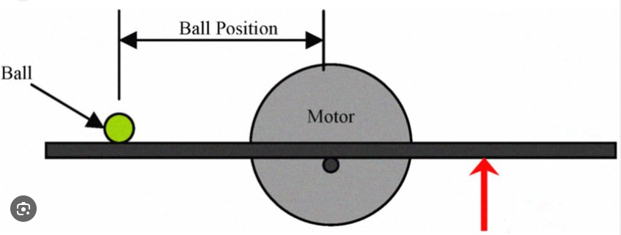
Presentation Outline
Motivation
Control Strategies
PID background
Tuning strategies
Project design and architecture
Practical lessons
Demo

Slide 3
Motivation
PID is widely used for many applications
Physical implementation of the algorithm
Learn implementation details beyond the theory
Disclaimer: ball-beam problem turned into beam problem ☹
Brief theory overview, most of the work on implementation
2k+ lines of code (Python, C++, JavaScript ,HTML)
STL files
Public repository with code, spec sheets, documentation (reference upon request)

Slide 4
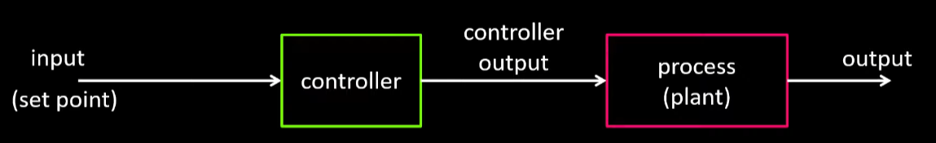
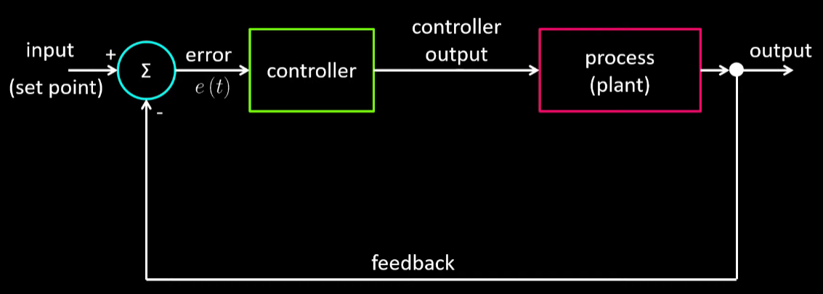
Control Overview and Strategies
Objective is to control the behavior of dynamic systems in an automated way
The system can be modelled by what’s called the “plant”
Arbitrary input vs controlled input
Controller: Open loop vs closed loop
A variety of methods for closed loop control (LQR, LQG, PID)

Slide 5
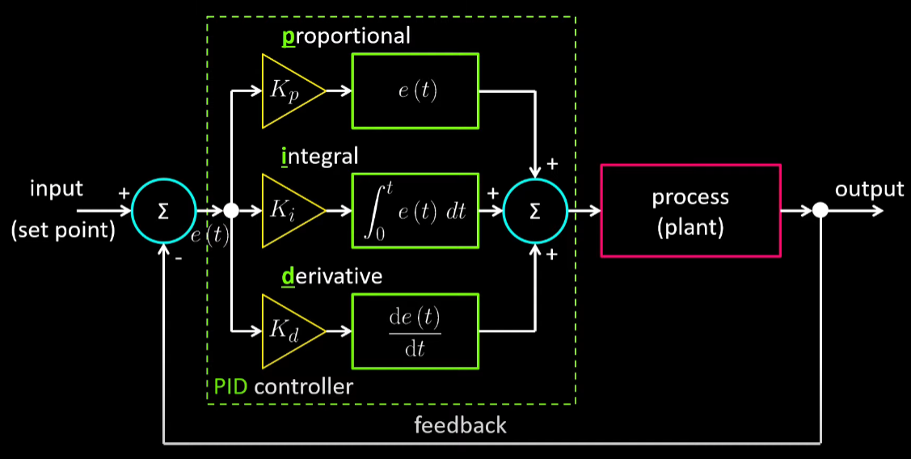
PID Background
Developed in 1911 by Elmer Sperry (arguable)
Closed Loop control
Reliant on error and 3 main gains: Kp, Ki, and Kd
No requirement on knowledge of system dynamics
*Pictures courtesy of teaching materials by DigiKey

Slide 6
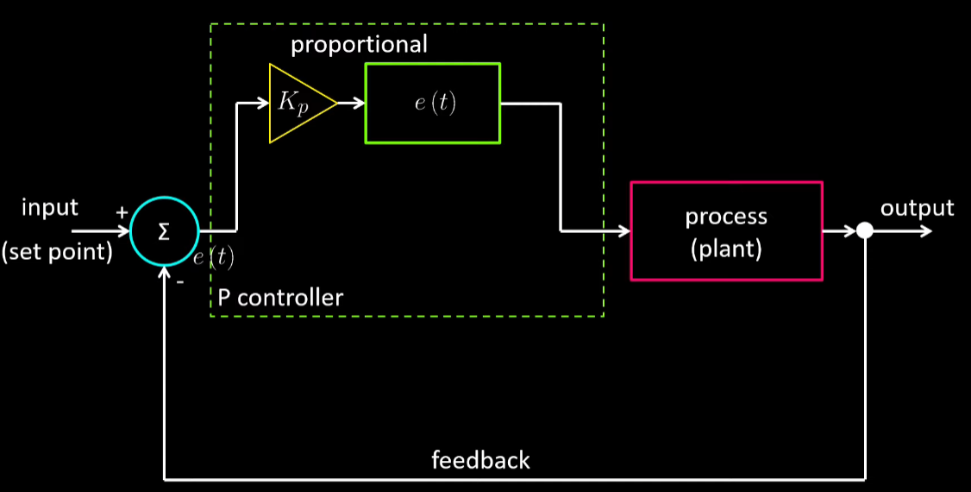
Proportional Term
Kp multiples the error by a constant value
Input to the process is modified by a proportional response to the error
P control

Slide 7
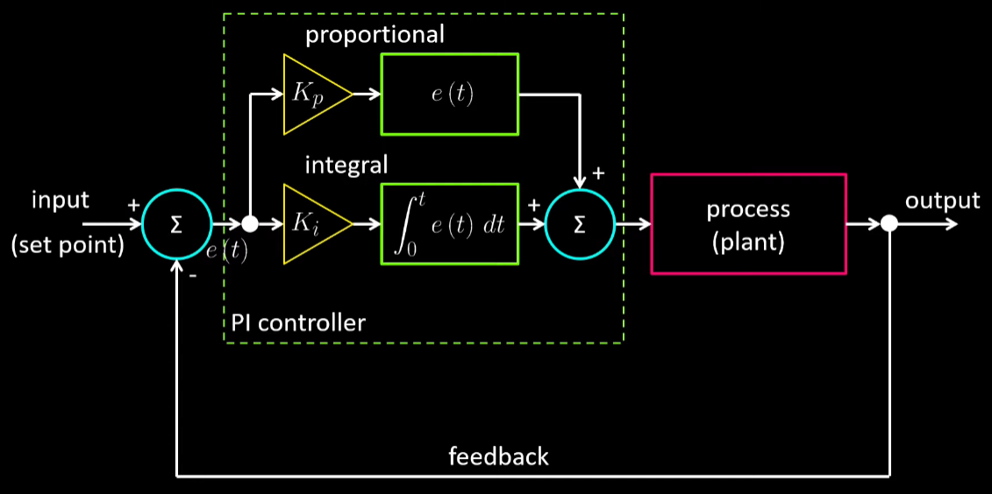
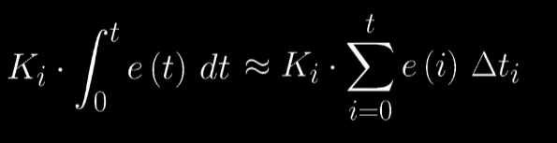
Integral Term
Ki multiplies the accumulated error
This is especially useful for steady-state error (dynamics & input forms)
PI control, usually enough for most common applications

Slide 8
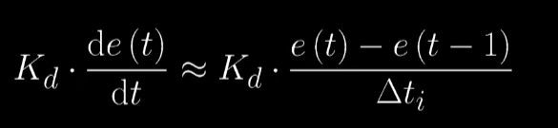
Derivative Term
Kd multiplies the rate of change of the error
This is especially useful for reacting to oscillations

Slide 9
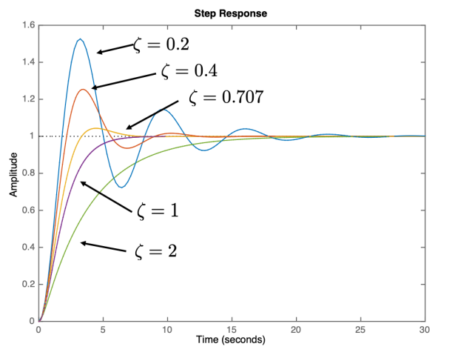

Step Response
For generic second order systems
Tuning Kp, Ki, and Kd adjusts the step response
Introduction to Feedback Control, Beard

Slide 10
Tuning
Trial and error
Different algorithms
Simple sequential adjustment
Classical methods:
Ziegler-Nichols
Cohen Coon
Internal Model Control

Slide 11
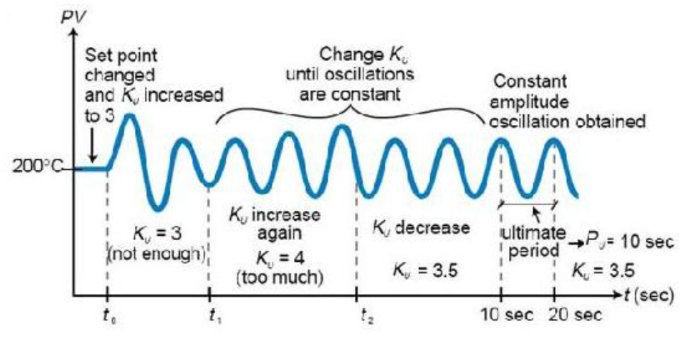

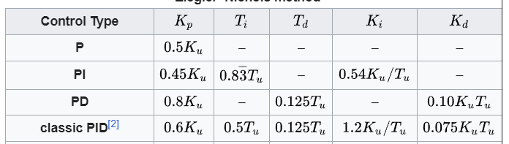
Ziegler-Nichols Method
Uses only Kp tuning and then Ki and Kd are derived
Step response with P control and use oscillations and relationships to derive Ki and Kd

Slide 12
Project Design and Architecture
Disclaimer: distance sensor issues
Only implemented PID control on the angle of the beam, same principles apply
Software and hardware Integration

Slide 13
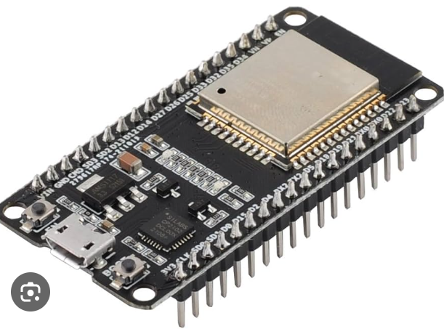
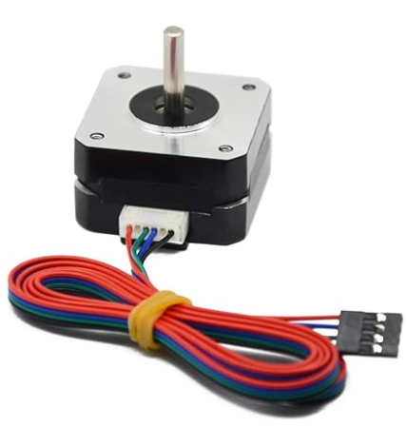
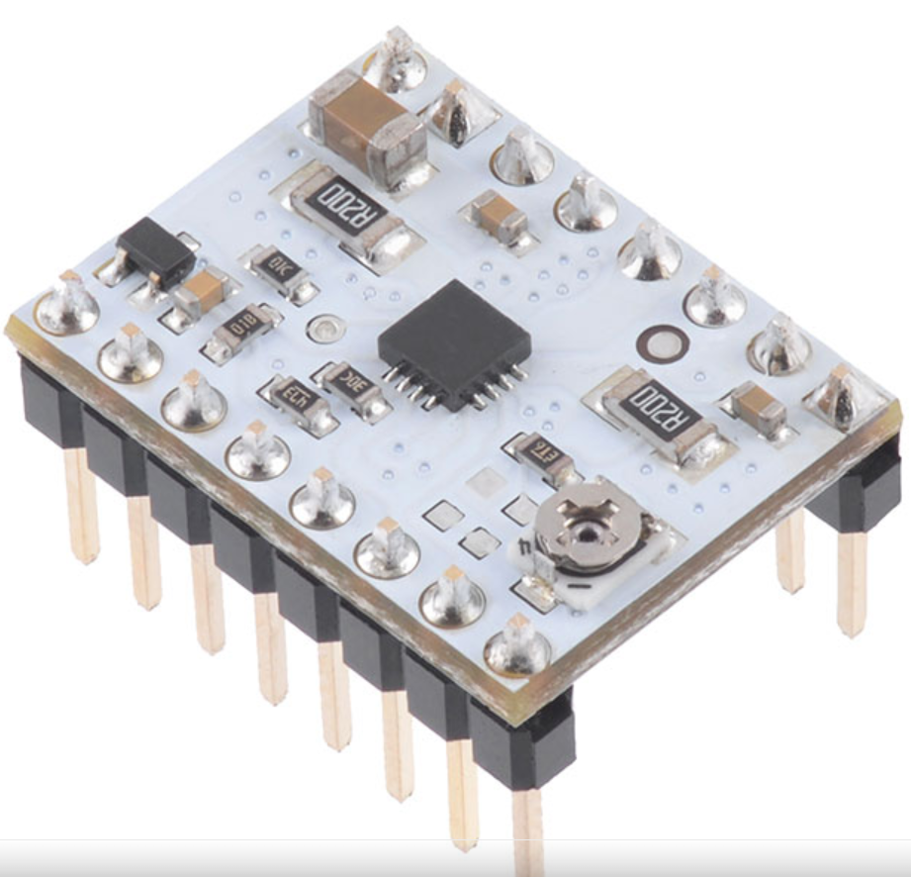
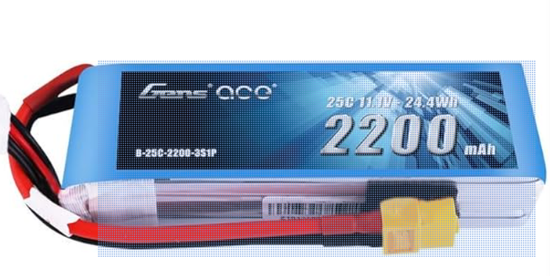
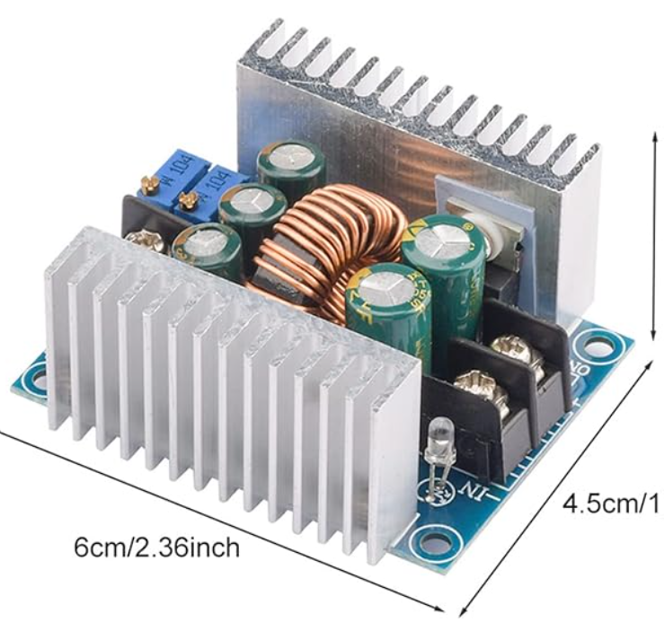
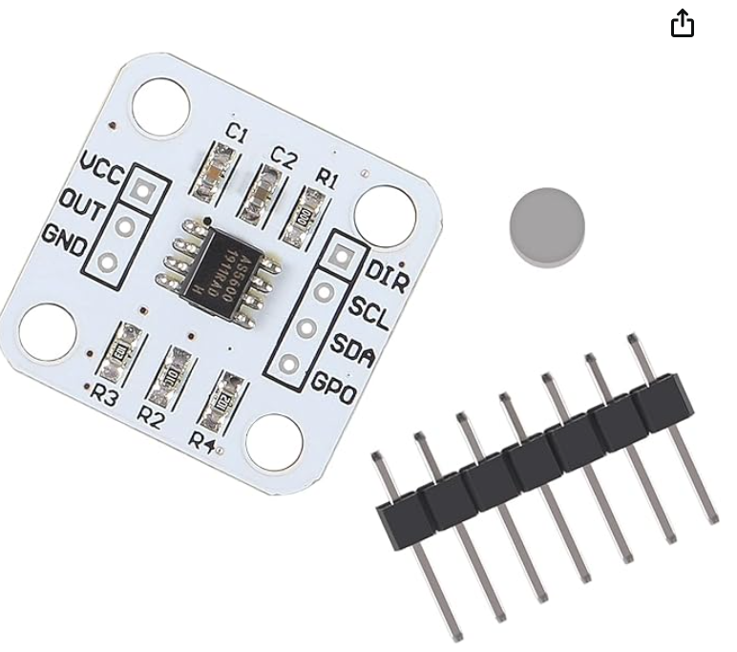
Hardware Description
3D printer parts (modeled in Fusion360)
Power system
Angle adjustment (NEMA 17 stepper, DRV8834)
Signal adjustment and serial communication

Slide 14





Software Tools and Architecture
PlatformIO (VSCode Micro IDE) – embedded programming
Hardware driver libraries (stepper driver, magnetic encoder, distance sensors)
Serial communication – USB Serial
Flask Web App

Slide 15
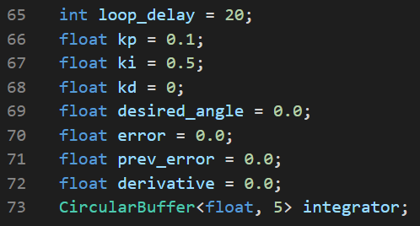
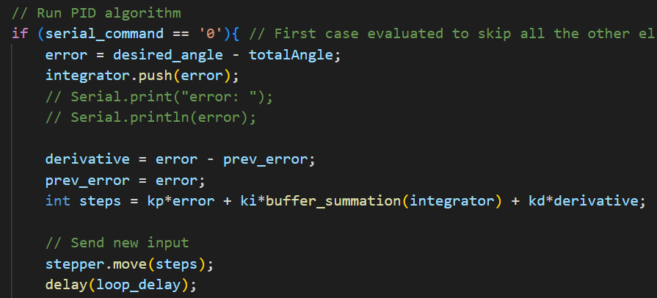
Key Code Snippets

Slide 16
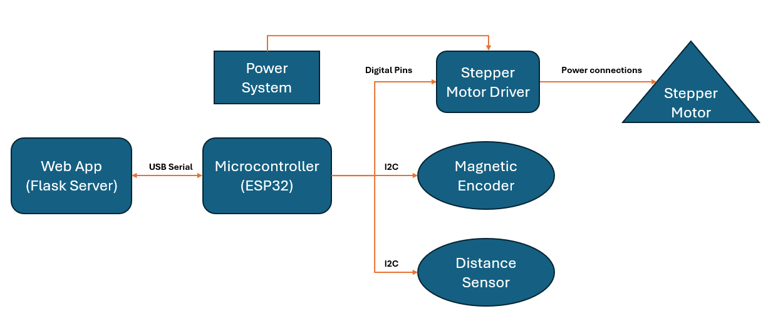
Architecture

Slide 17
Practical Lessons
Sensor characterization and calibration are crucial
Spec sheets and practical experimenting
Software and hardware understanding
Unit testing for each system stage
Useful to have separate subprojects for drivers
Tradeoff between sensor cost and accuracy
Short iteration periods
In case of concatenated or nested control, intermediate parameters should be controlled faster than final parameters (angle and position of ball beam system)
Keep in mind all the physical limitations of each component
3D Printed parts were too heavy in some cases for the current limits applied to the stepper motor

Slide 18
DEMO

Slide 19
QUESTIONS?

